Slide 1
CloudCME™ Quick Guide
July 25, 2024

Slide 2
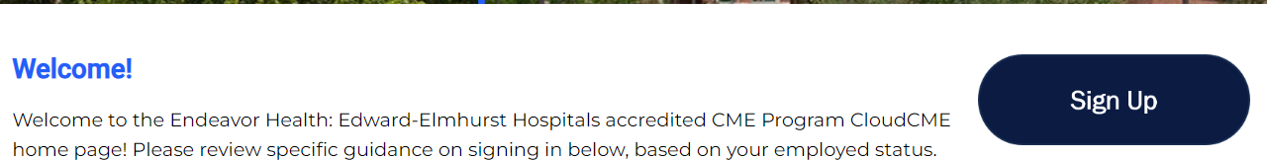
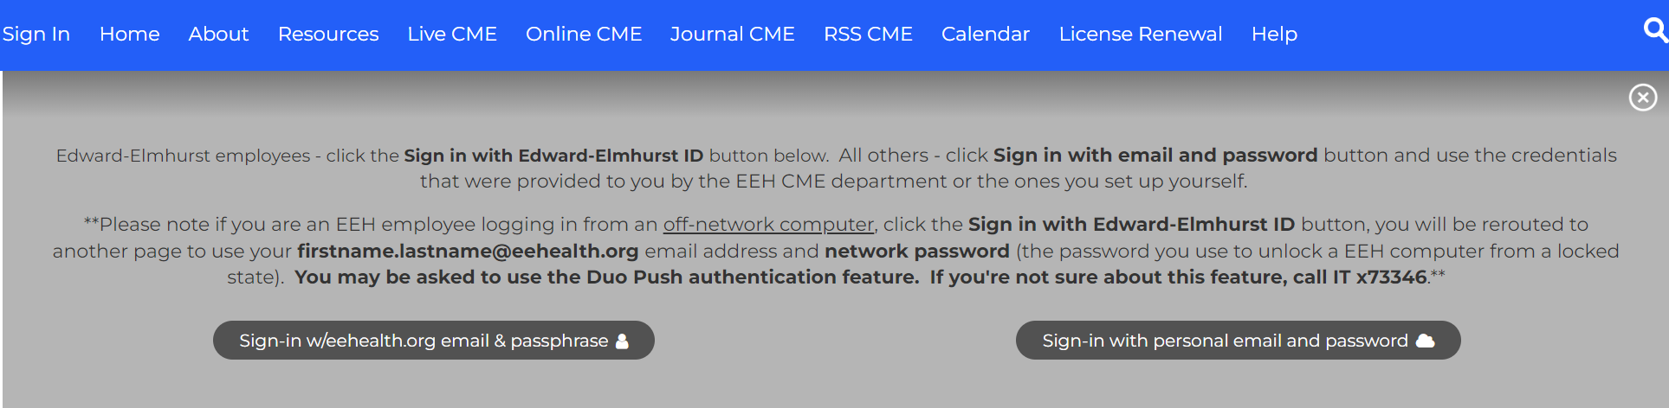
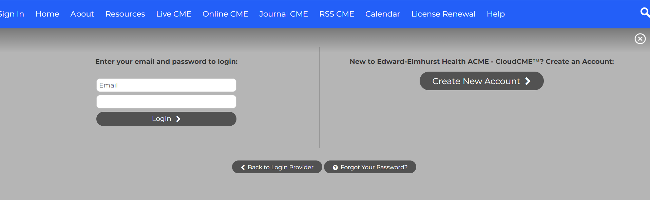
How to Sign Up for a CloudCME™ Account
If you DO NOT have a Cloud CME account, you will need to create one.
Access Cloud CME website at https://edward-elmhurst.cloud-cme.com/default.aspx
  Edward/Elmhurst staff with an @eehealth.org email address
    Click “Sign Up”
    Sign in with @eehealth.org email & passphrase
    Create new account
  Staff outside of Edward / Elmhurst
    Click “Sign Up”
    Sign in with personal email and password
    Create new account
A
B
C

Slide 3
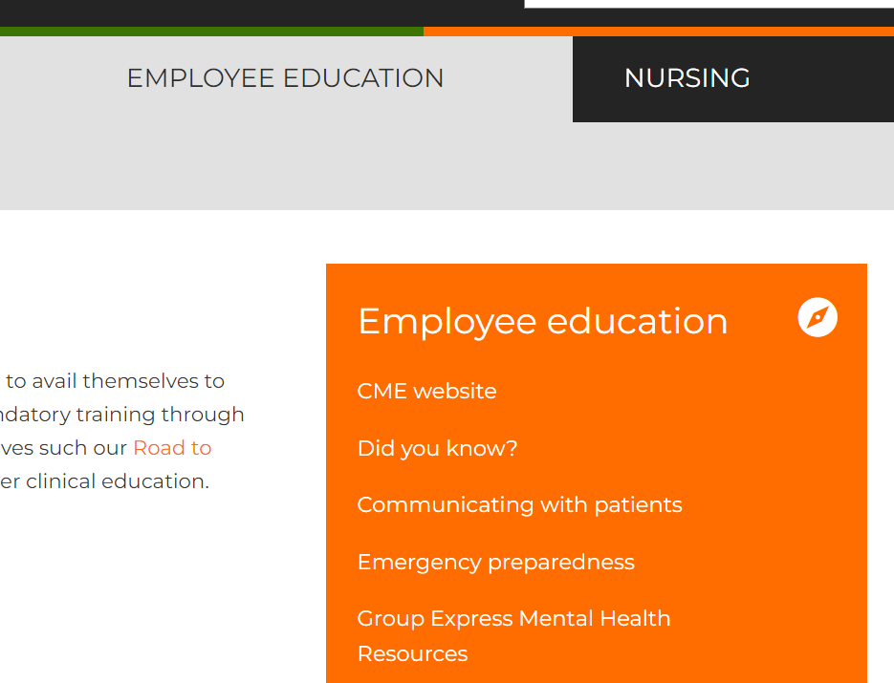

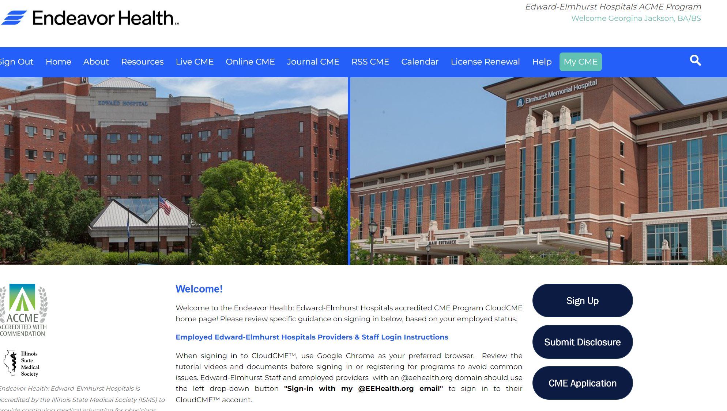
Signing In to CloudCME™ on a Computer
Edward/Elmhurst staff, go to the employee intranet: https://employee.eehealth.org/
Navigate to Employee Education on the top banner
Click “CME Website” in the drop-down menu.
You will then arrive at https://edward-elmhurst.cloud-cme.com/default.aspx.
  Bookmark this page for quick access!
Once there, you should see your name on the upper right corner of the screen, if you signed in via a network computer. See notes at bottom of slide for more information
Staff outside of Edward / Elmhurst go straight to https://edward-elmhurst.cloud-cme.com/default.aspx. Click “Sign In” on the left-hand side.
Notes:
If you have already signed on to a computer onsite with your username and are registered with an @eehealth.org username, you will notice that your name automatically appears in the upper right corner. If you are using a personal email and password, you will need to click on the “Sign In” button on the top right of the screen and, when the drop down appears, click “use my own email and password”. If you did not sign in to a network computer (i.e., an open-access computer similar to on the floors), you need to sign-in to CloudCME™ using the appropriate login information.

Slide 4

Signing in on the CloudCME™ App
Before downloading the app, ensure that you have a profile set up via computer. Search the App Store or Google Play Store for CloudCME.
Organization code: edward-elmhurst
Click Login or Create Account. Click the top button to sign in with your @eehealth.org email address
If you do not have an @eehealth.org address, click on the bottom button (sign-in with personal email and password)

Slide 5
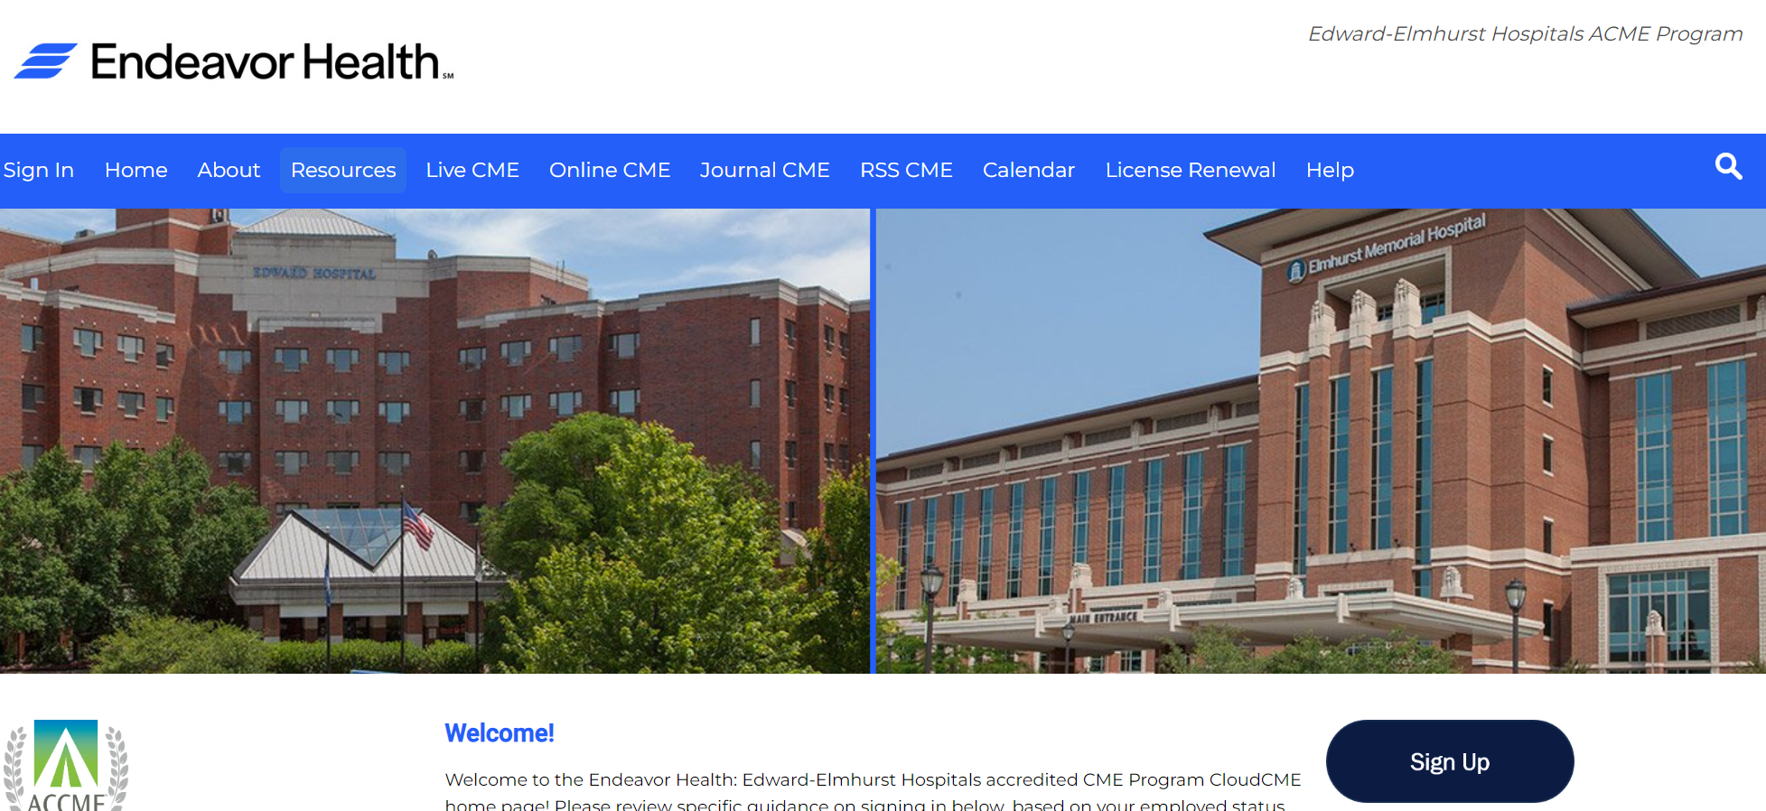
CloudCME™ Portal
Providers with @eehealth.org usernames have a single sign-on, (use their network password)
Physicians with a personal email as their username have their own personal password. If you do not remember, or would like to switch to your @eehealth.org username, contact eeh-acme@eehealth.org

Slide 6
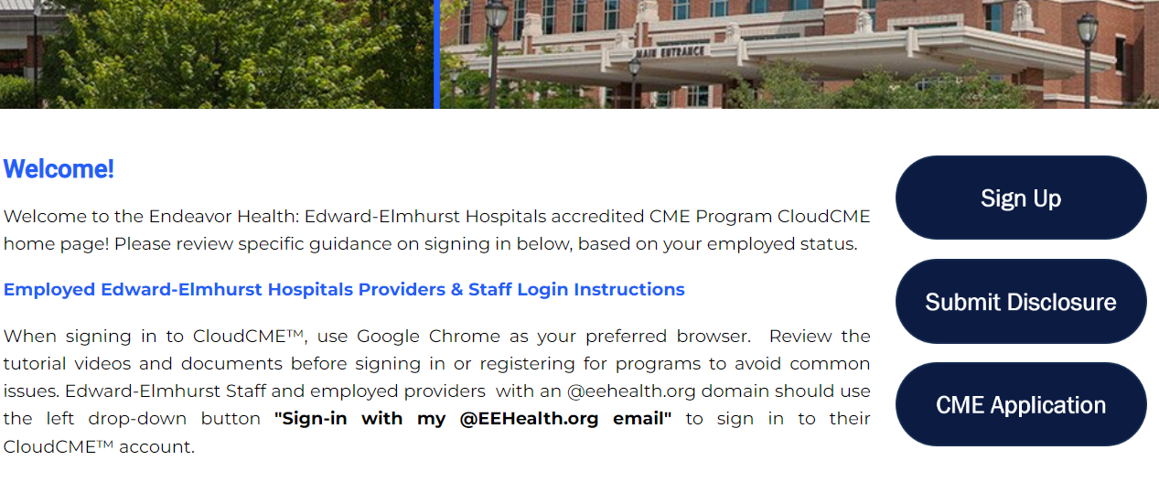
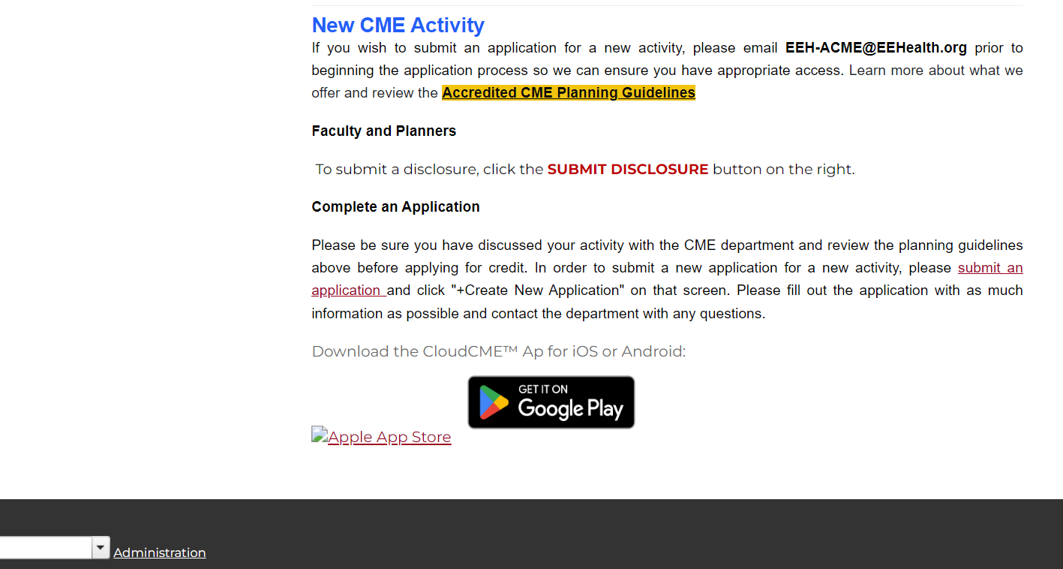
Planner Administrative Sign-In
Once logged in, to the right of the screen note these important links:
  Submit Disclosure
  Complete Pre-Application
The Submit Disclosure button is used by planners, speakers, and anyone involved in an activity
The CME Application button is used by planners to submit applications for review by the ACME Department
Scroll toward the bottom of the page to see two more important links:
  Accredited CME Planning Guidelines
  Administration (very bottom)
The Accredited CME Planning Guidelines provides a nice overview for planners
The Administration link takes you to the administrative area of CloudCME™, where planners’ functions are found. Please contact us if you do not see it.
Notes:
Once signed in, planners should make sure they have appropriate access. Scroll to the bottom of the main CloudCME™ portal page. There are four important links that planners should be familiar with. The most important link is the Administration link. This will provide access to the RSS dashboard and other back-end CloudCME™ functions. Disclosure button: Disclosures are required from all planners, presenters, and anyone involved in content, planning or delivery of an accredited CME activity. Planners should not have any relevant financial relationships with ineligible companies. For a complete list of ineligible companies, contact the ACME department. Once a year RSS planners or department leaders submit applications for RSSs between October and November for the next year. The program and education committee reviews the applications in November and the ACME department builds the activities in CloudCME™ in December for the new year. The final link is the Accredited CME Planning Guidelines, this should be reviewed by planners prior to planning an activity or beginning an application. The instructions provides planners with all the necessary information regarding accredited CME activities and the standards for obtaining and maintaining credit.

Slide 7
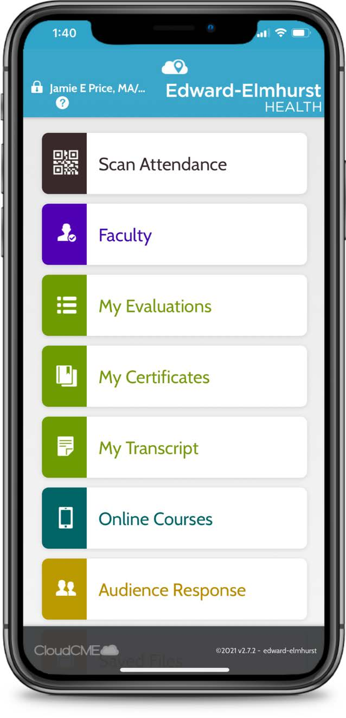
How to Claim Credit – Option 1 (During Activity)
Scan QR Code
  The best way to claim credit at an activity is with a single QR code as you enter the room. The planner should have a QR code displayed that coincides with the date, time, and location of the activity you are attending
  Using the CloudCME app (standard Camera app will not work) click “Scan Attendance”; point phone camera at QR code supplied for activity. If an error code shows up, make sure you are allowing the CloudCME app access to your camera in phone settings
    The QR code will only work 30 minutes prior to activity starting, and 30 minutes after its’ conclusion

Slide 8
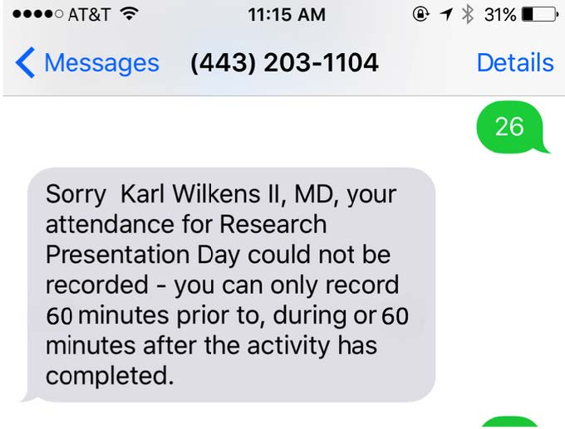
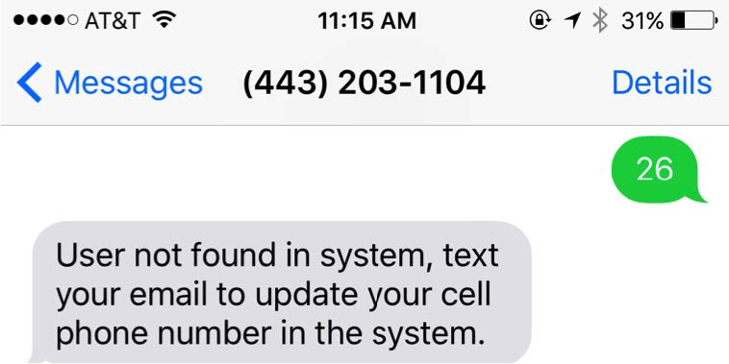
How to Claim Credit – Option 2 (During Activity)
SMS Text
  To set up SMS texting abilities with CloudCME™, text your email address to 630-835-0554 to "pair" your phone with your account
  To record attendance and claim credit during an activity, text the activity code to 630-835-0554. Once recorded, a confirmation response is received. If a cell phone # is not associated with the account, or there is no account, a couple error messages may be returned.

Slide 9
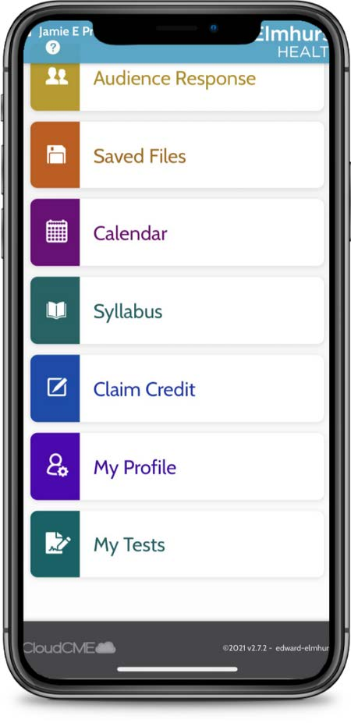
How to Claim Credit – Option 3 (During Activity)
Claim Credit Button (App)
  This option is particularly helpful if a participant is not attending for the entire activity, or if they did not scan attendance during the time frame
  Click on “Claim Credit” within the CloudCME app and enter the Activity ID provided by the planner, then click the blue “Verify Event ID” button
  Select the type of credit (AMA PRA Category 1 Credit for physicians or non-physician attendance), the number of hours in attendance, agree to the attestation, then sign/type full name
  Once complete, click on the blue submit button in the top right corner of the screen. This must take place within 30 minutes of the start/end of the activity

Slide 10
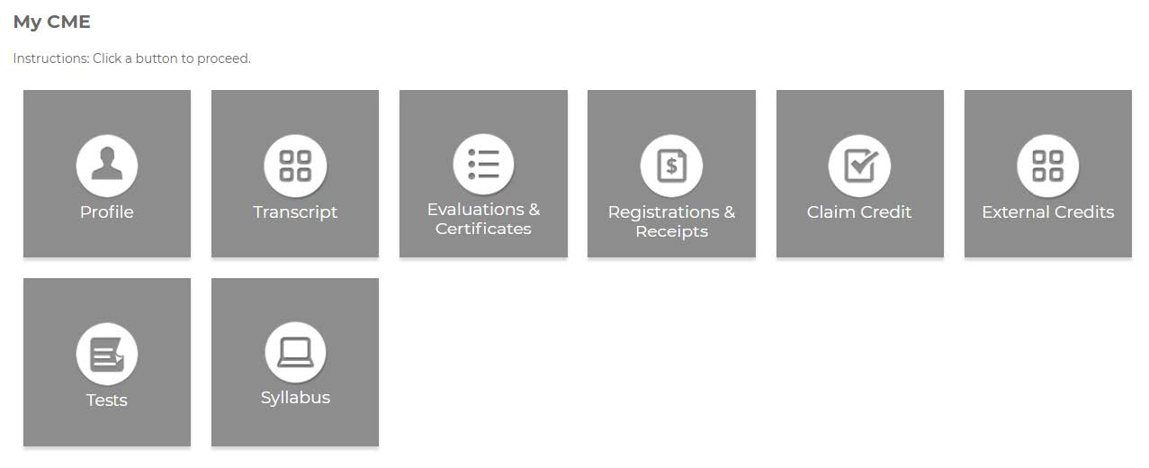
How to Claim Credit – Option 4 (After Activity)
Claim Credit from Computer
  Sign-in to CloudCME™ from a computer or laptop. Click on the green MyCME button at the top right of the screen
  On the next screen, select the “Claim Credit” button
  Enter Activity ID provided by the planner and click “Verify Event ID”
  Enter the credit type, number of hours attended, agree to attestation, and click submit
This option can occur at any time after the activity has been completed

Slide 11
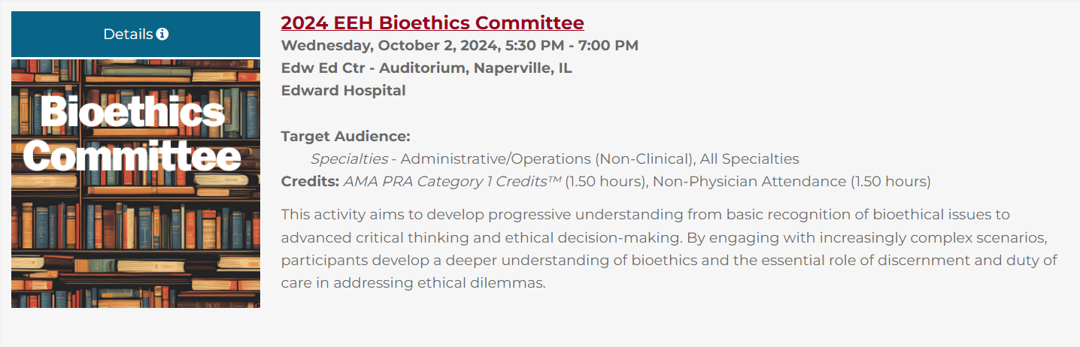

Registering for Activities (Web)
Once signed in, click the blue “Details” button or the topic title of a CME activity
On the next screen, click the black “Register” button.
  Registration is required for all live activities. Other types may not require registration.
If appropriately signed in, your username is visible in the top right corner
Click the blue “Continue” button at the bottom, after answering required and optional questions. Click “Finish:
Crucial step: If attendance options are presented, please select your appropriate attendance format (live, video, etc.)

Slide 12
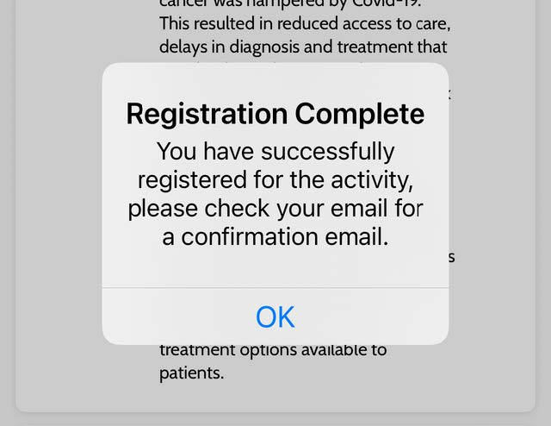
Registering for Activities (Mobile App)
Click the “Calendar” button to locate activities
Once the accredited CME activity is located, registration is usually required. Click the shopping cart icon to launch registration
If appropriately signed in, your username appears in red on the screen
Click the blue “Continue” button at the bottom, after answering required and optional questions. Click “Finish:
Crucial step: If attendance options are presented, please select your appropriate attendance format (live, video, etc.)
Registration is not complete until you see a popup on your screen

Slide 13
Registration Issues on Safari Browser
If “Prevent site cross-checking” is enabled on your Safari browser on an iOS device, an error message appears from “Frevvo” preventing registration
  Frevvo is CloudCME™’s form software
Google Chrome and Microsoft Edge browsers do not enable this setting by default.
Google Chrome is the preferred browser for CloudCME™ utilization.
Alternatively, you may disable this setting on your Apple device

Slide 14
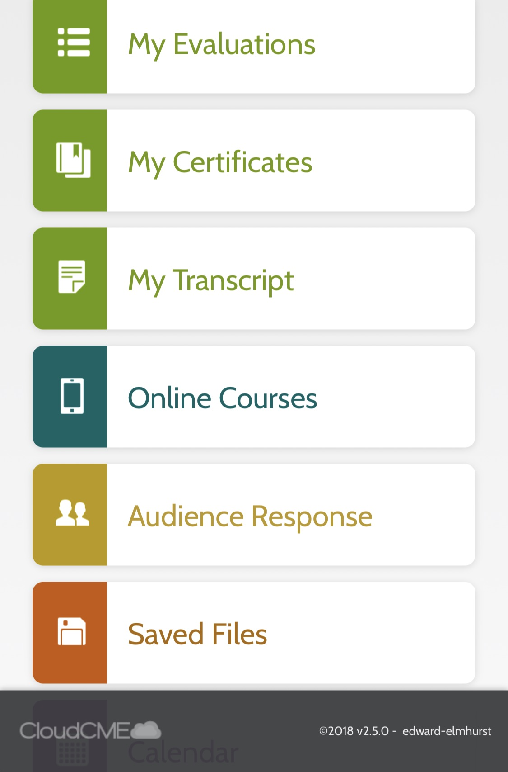
Completing an Evaluation & Accessing Certificates
Upon activity completion, evaluation requests are automatically sent to documented participants via the email in the user’s profile. To view outstanding evaluations and access corresponding certificates, follow these instructions:
  Sign into the CloudCME™ as usual
  Click on the grey Evaluations and Certificates button
  Once evaluations are complete, the orange “Download Certificate” appears
  Evaluations and certificates can also be completed and accessed from the app.

Slide 15
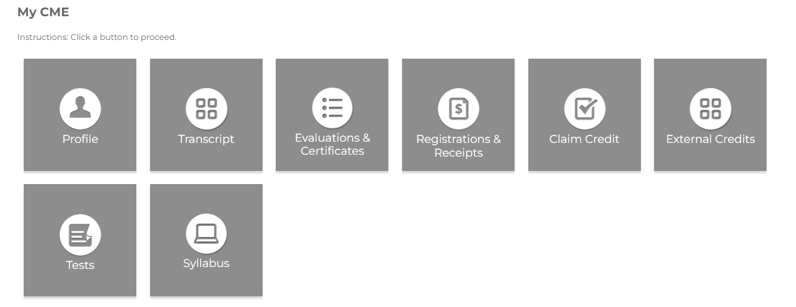
Accessing Presenter Material for an Activity
Users can access presentation material for any registered activity through the CloudCME™ portal or via the CloudCME™ app
  If you do not register for an activity, you are not provided access to the syllabus for that activity
Once signed in, click on the “My CME” button on the top right
Once opened, you will be able to choose the appropriate activity. Click the Syllabus button on the right to open agenda items.
This may also be done on the app under the “Syllabus” tab

Slide 16
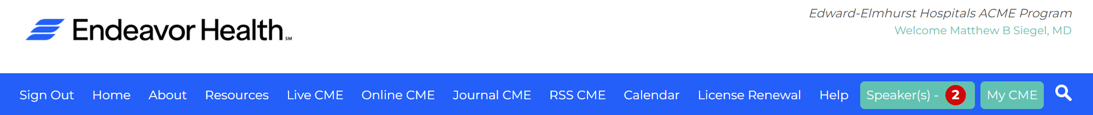
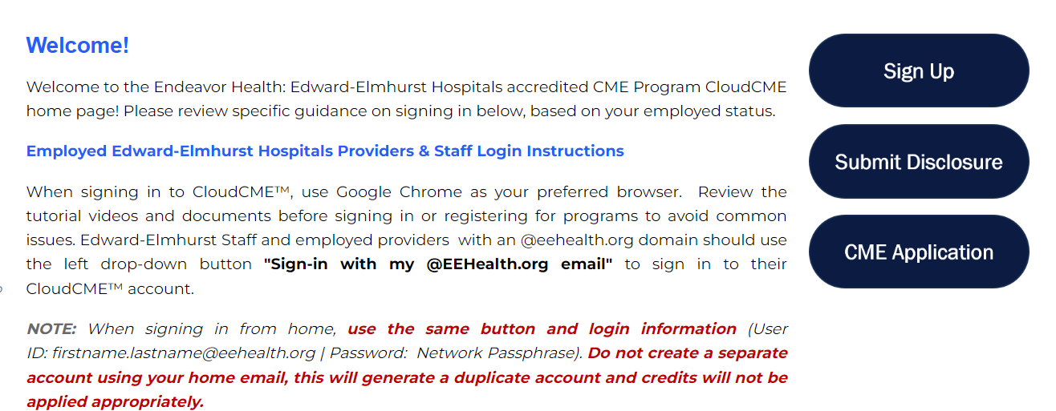
Completing a Disclosure
There are two different ways to access a disclosure. Speakers and planners must complete a disclosure annually and prior to any activity for which they are presenting or planning
  Option 1: Sign into CloudCME portal on a computer, click on the green “Speaker(s)” tab button. Answer questions as they relate to you, the speaker or the planner. Submit when complete
  Option 2: Navigate to the right of the home page and click the “Submit Disclosure” button and follow the steps.

Slide 17
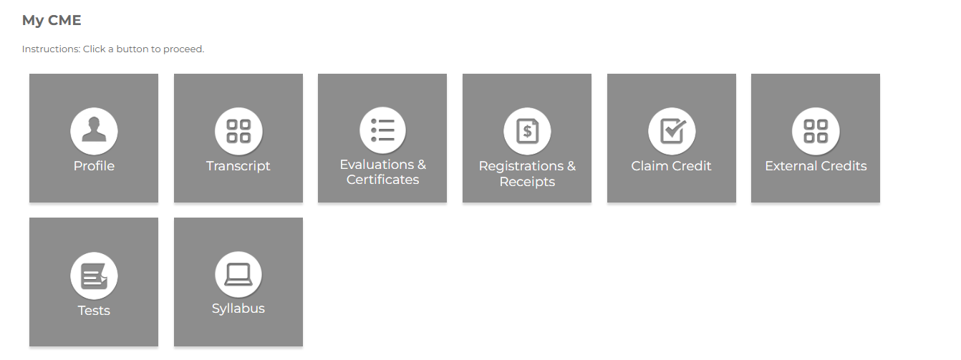

Accessing Transcripts
Users can access transcripts for any given period through the CloudCME
  If you do not document your attendance or complete evaluations, credit does not record onto transcripts
Web: Sign into the CloudCME portal, click “MyCME” on the top right, then click the “Transcript” button. Users can download, print, save, or email the transcript
Mobile: Click “My Transcript”
Admins can access transcripts for their respective VP, AVP, Directors, etc. for any timeframe through the web portal
  Admins should have a text box at the bottom of the webpage where they can type in the last name of the individual they are looking for. This effectively allows them to “alias” as that individual. From there, the same steps above are followed

